Slide 1

Optimizing Data Center & Digital Asset Management

Slide 2

The Challenge – need to update
Data centers consume 1-2% of global electricity
Energy costs represent 60-80% of operational expenses
Fluctuating energy markets create financial risk
Balancing carbon footprint with computing demands

Slide 3
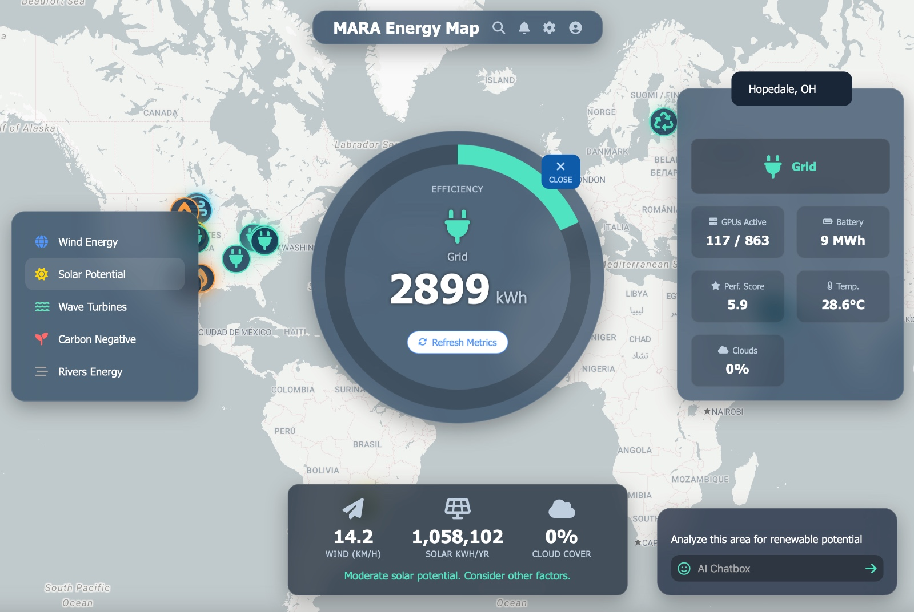
Introducing Panoptic
Comprehensive Energy Intelligence
Global monitoring and optimization across facility portfolio
Real-time analytics with
predictive modeling
ML-powered infrastructure
investment guidance

Slide 4




Integrated Asset Management
Real-Time Monitoring
Capacity Optimization
Unified dashboard for global facilities
AI-powered global resource allocation
CapEx Investment Analysis
Live Trade Opportunities
Sustainability metrics and reporting
Identification of prime sites for battery and other infrastructure investment opportunities

Slide 5




Infrastructure Investment Analysis
Opportunity Identification
ROI Calculation
Location Optimization
Detailed financial modeling and projections, implications for energy cost hedging
Geographic analysis for maximum efficiency based on climate, internet connectivity, and regional costs
Automated detection of potential infrastructure investment sites

Slide 6
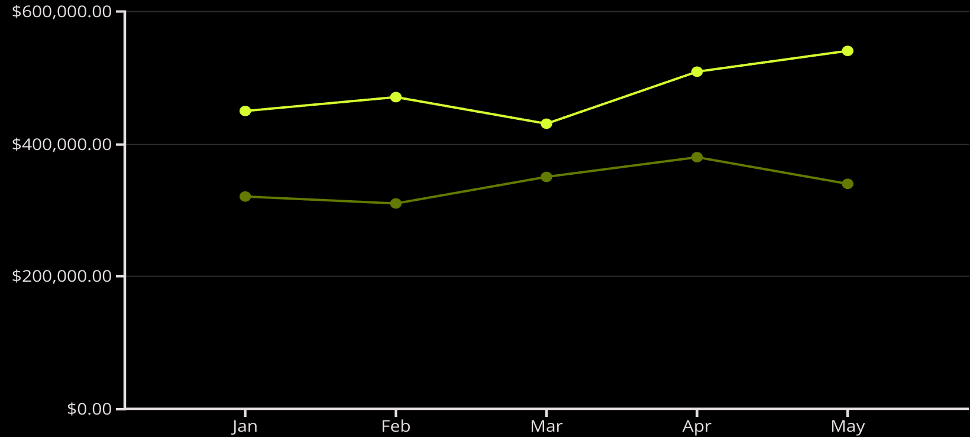
Integrated Portfolio Risk Management
Advanced Financial Hedging
Unified bitcoin and energy exposure dashboard
Futures and options strategy recommendations
Exchange and OTC market connectivity
Energy Cost
Bitcoin Revenue

Slide 7








AI-Powered Recommendations
Predictive Analytics
Risk Assessment
Energy market movement forecasting, compatible with internal research forecasts
Portfolio stress testing scenarios
Opportunity Alerts
Hedging Strategies
Real-time arbitrage notifications
Automated derivative selection

Slide 8
Why Panoptic?
22%
35%
3X
Energy Cost Reduction
Risk Exposure Decrease
ROI Multiplier
Average savings for enterprise clients
Through optimized hedging strategies
For infrastructure investment decisions
Transform your data center energy management with Panoptic

